Slide 1



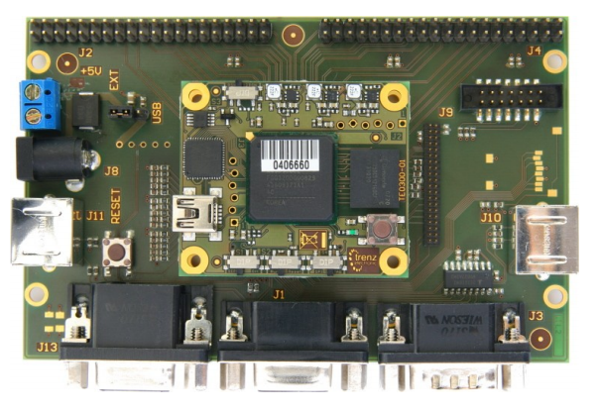

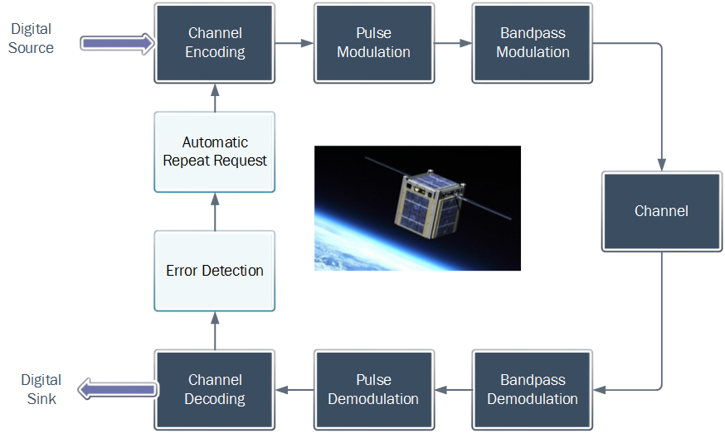
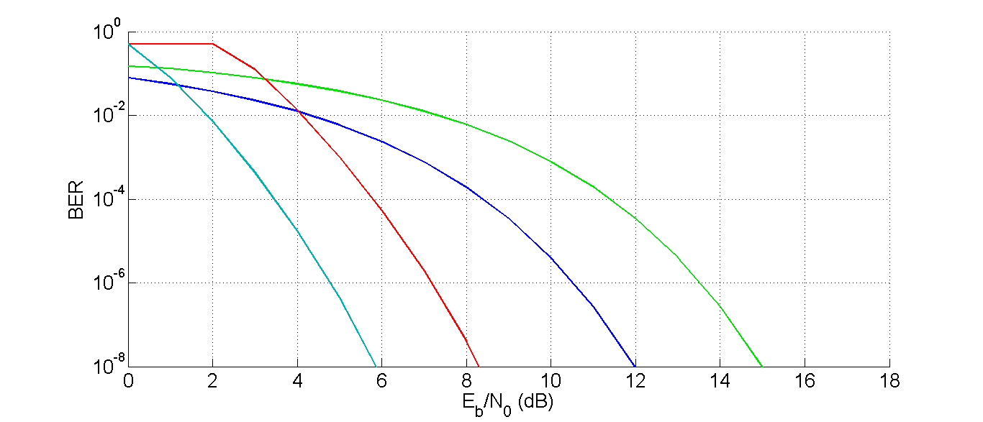
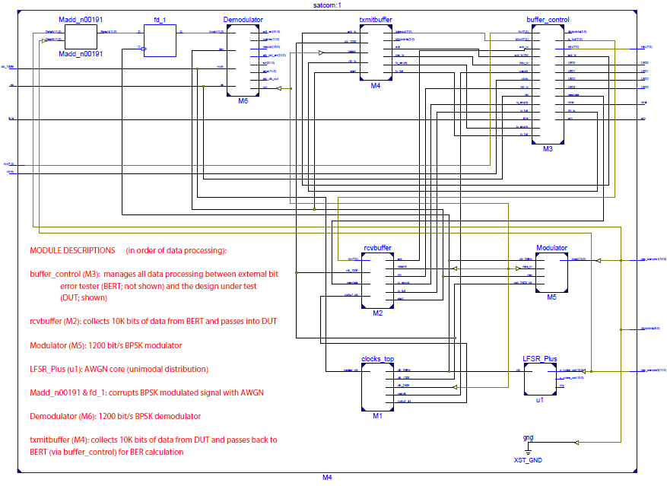
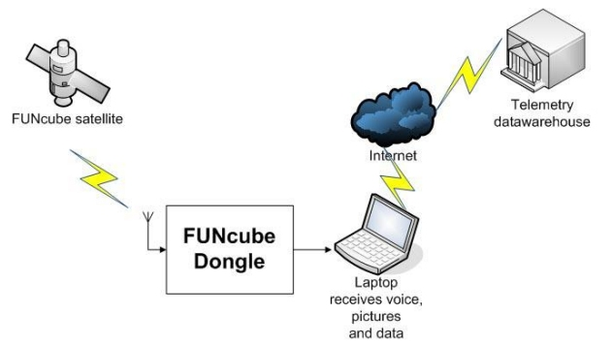
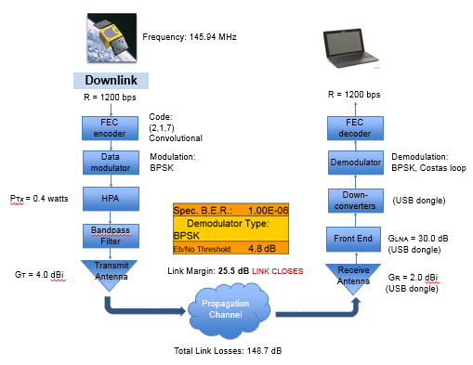
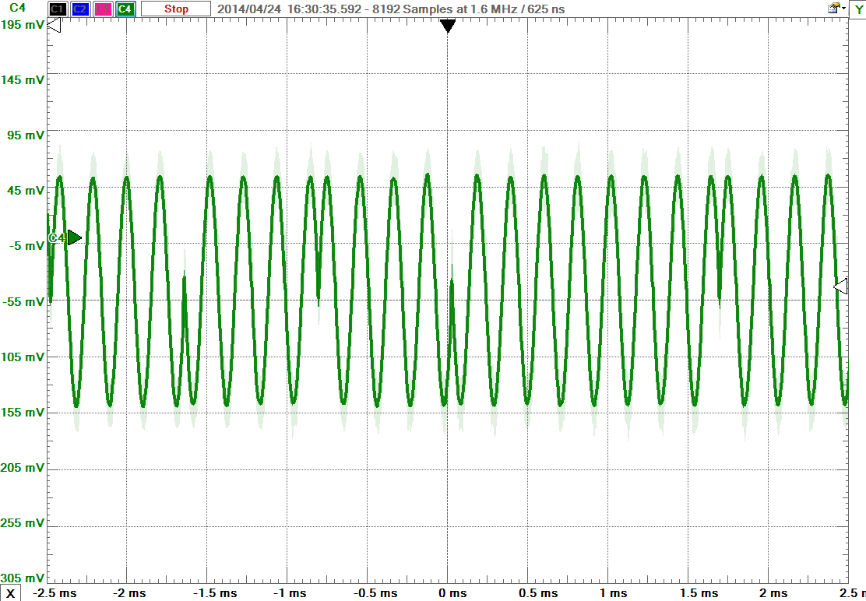
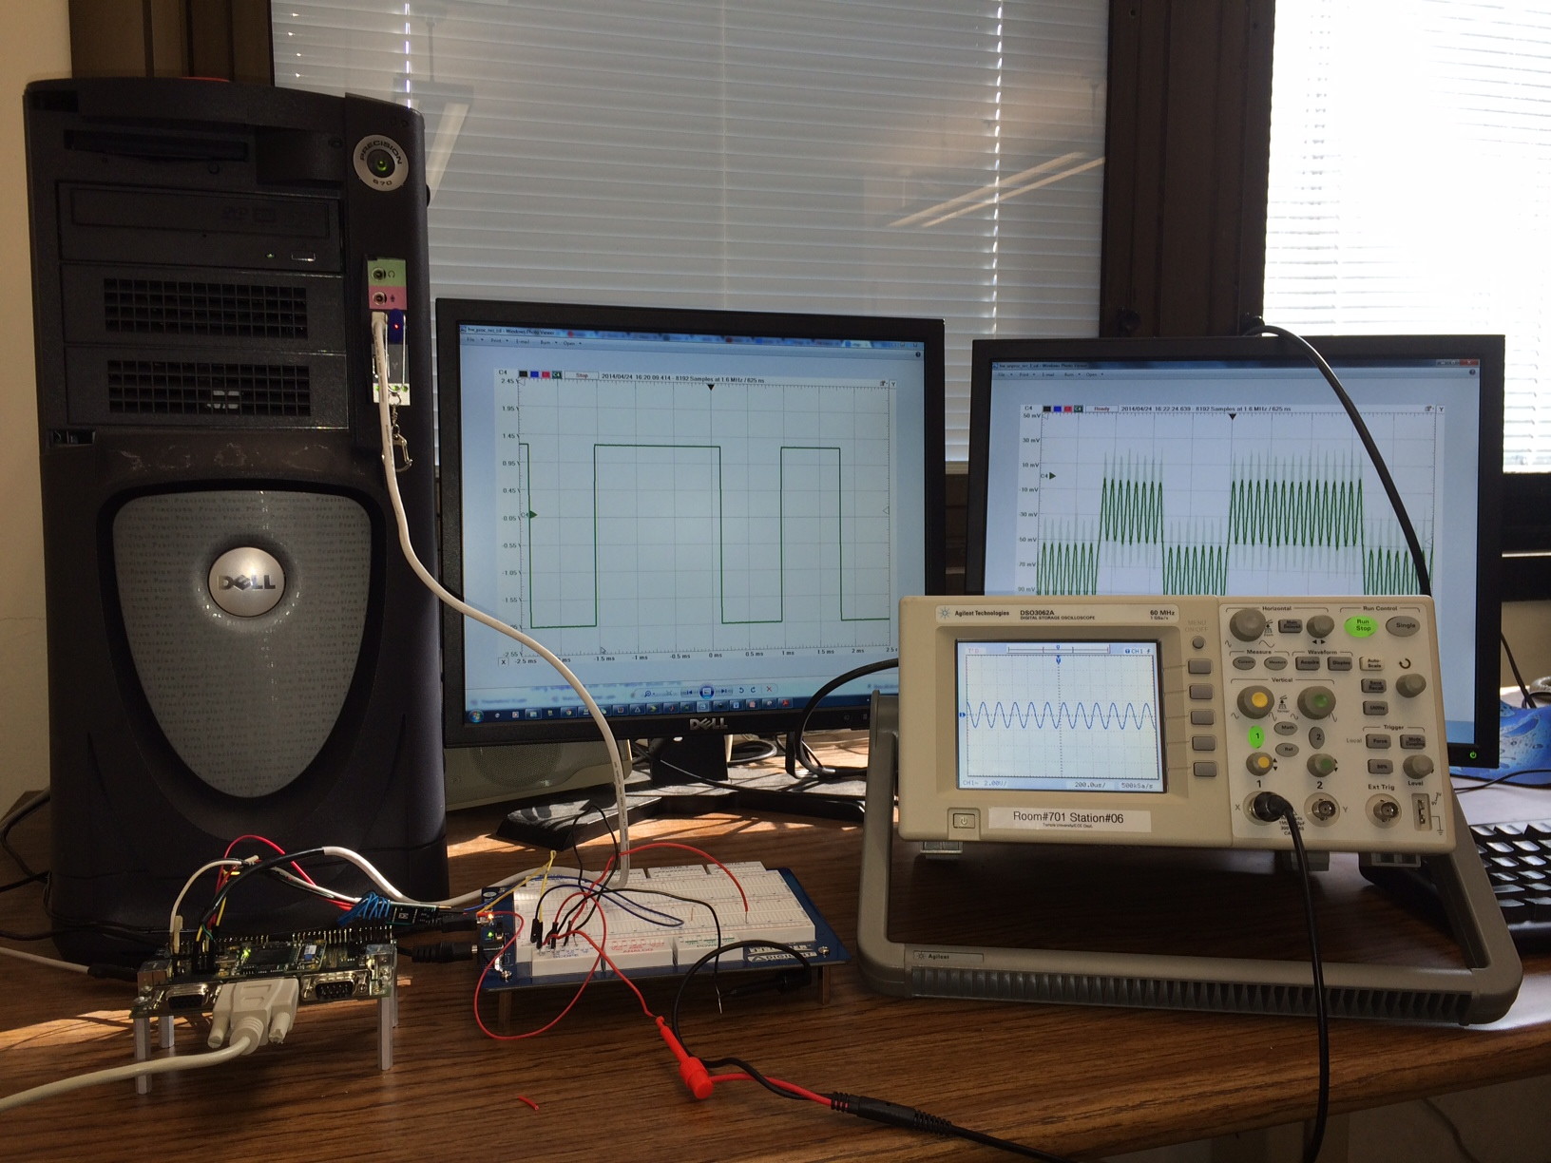
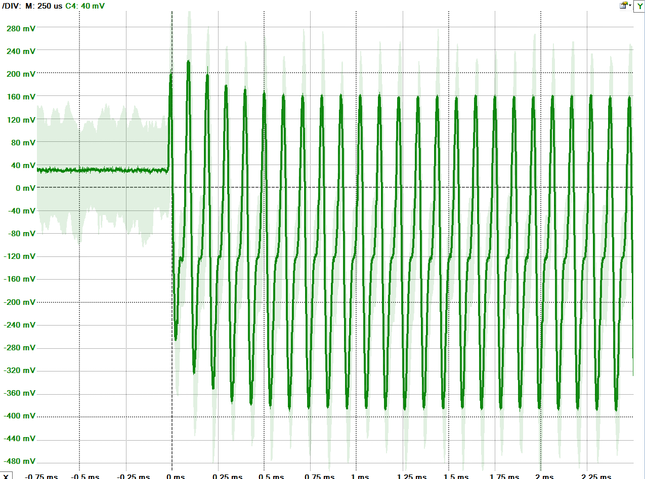
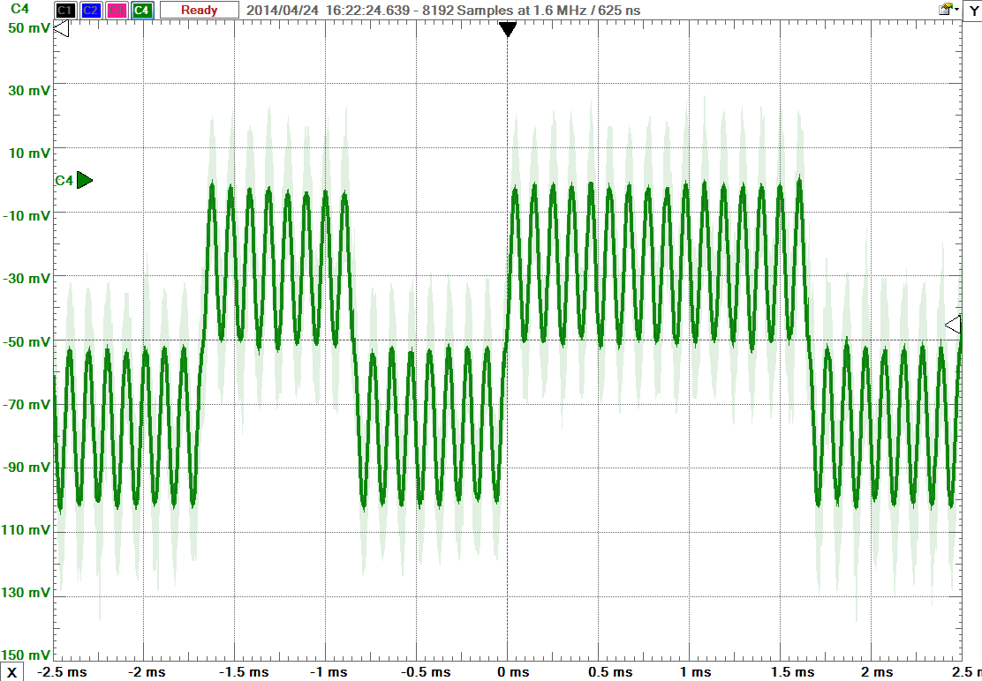
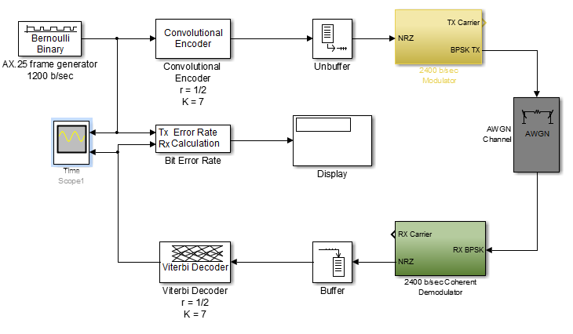
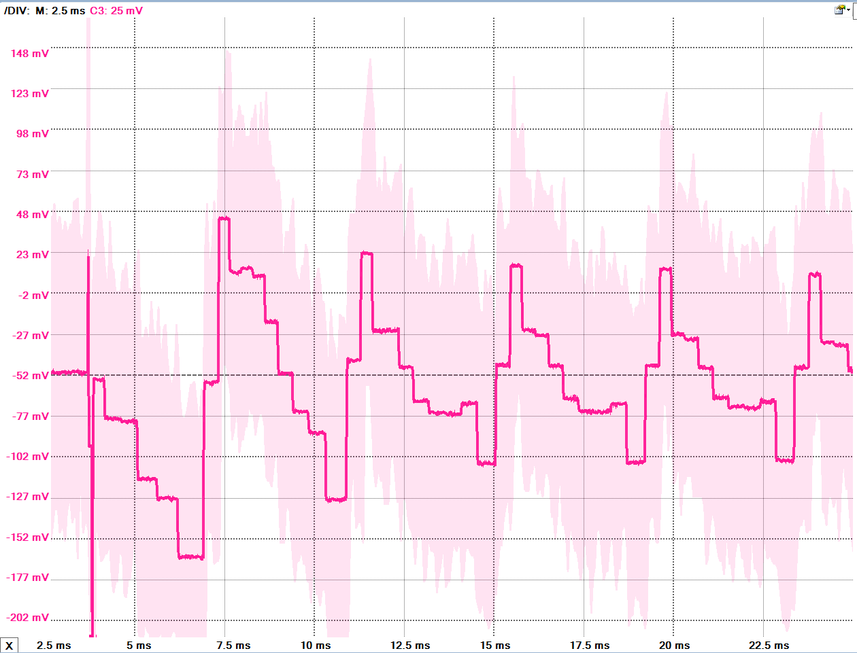
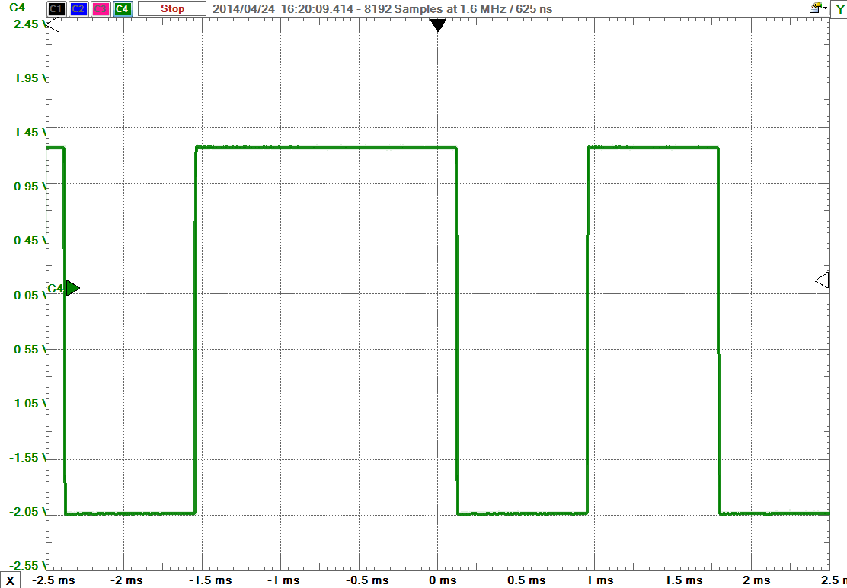
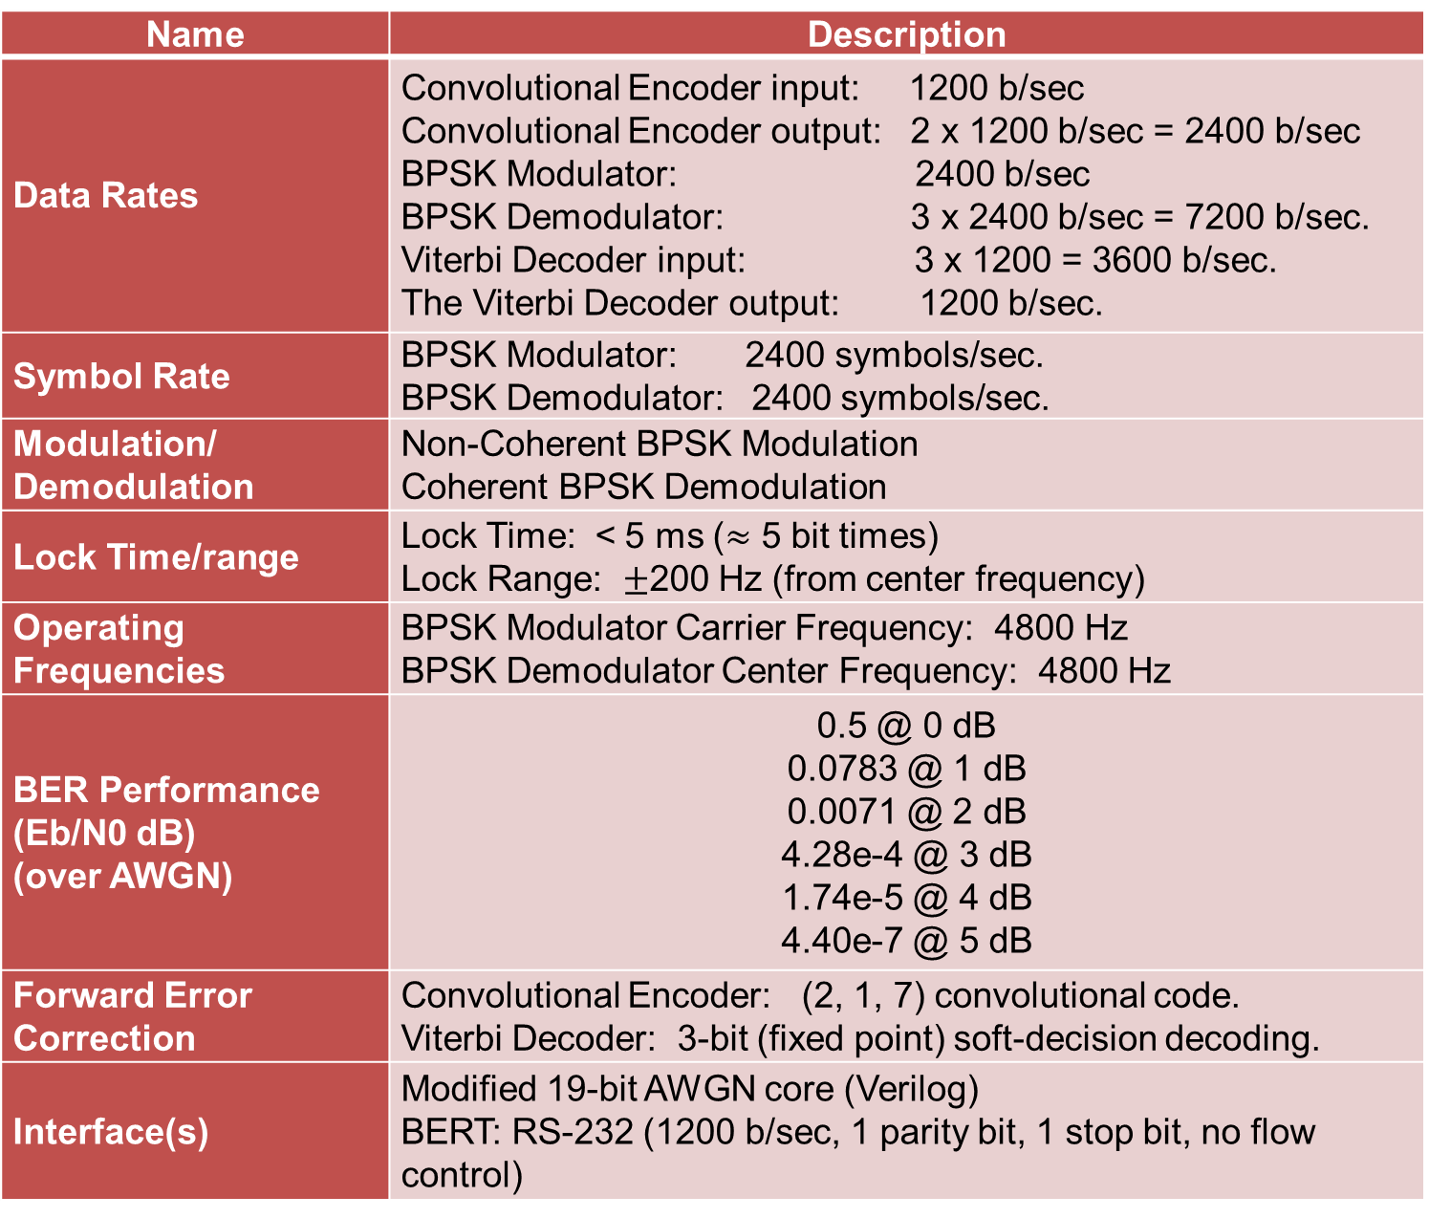
Acknowledgements
K3TU
BPSK Modem with Convolutional Code
PCG
Cedric Destin, Brandon Keith, Brian Thibodeau
Programmable Communication Group
Project Advisor: Dennis Silage, PhD
Abstract
Amateur radio satellite telemetry is the process of using the amateur radio frequency bands to transmit telemetry data from a miniaturized low-Earth orbiting satellite to a ground station. The most prevalent means of transmitting telemetry data down to Earth is not nearly as power-efficient as it could be. Inefficient power usage makes amateur satellite telemetry an expensive and esoteric hobby to get involved with. This senior design team aims to demonstrate how forward error correction (FEC), specifically convolutional coding, can make amateur satellite telemetry more power-efficient and hence make the hobby more accessible to prospective amateur satellite operators. We use FPGA hardware to implement a 1200 b/sec BPSK modem with a (2,1,7) convolutional encoder and soft-decision Viterbi decoder. The performance of the proposed modem is evaluated using an AWGN core and a thorough budget link analysis. The comparison of BER and budget link results between traditional BPSK and FEC-BPSK demonstrate the potential of the proposed solution.
Motivation
It has been shown that forward error correction can dramatically improve bit error rate performance (BER) in amateur packet radio satellite telemetry. Additionally, other methods such as binary phase shift-keying (BPSK) modulation is more reliable and bandwidth-efficient than audio frequency shift keying (AFSK) modulation. A quick survey of active amateur radio satellites reveals that many of them use FSK modulation and lack forward error correction capabilities.
This senior design project aims to demonstrate how BPSK modulation with forward error correction (specifically convolutional coding) makes amateur radio satellite telemetry more accessible and reliable. The ultimate goal of this senior design project is to demonstrate the improved network reliability (in terms of BER) and accessibility (in terms of link margin) that results from implementing BPSK modulation with convolutional coding in amateur packet radio telemetry satellites and ground stations.
What is amateur radio satellite telemetry?
Radio Amateur Satellite Corporation (AMSAT) is an educational organization with the vocation of promoting space research and space communication. Telemetry data communicated to ground stations is one way that AMSAT seeks to promote the space adventure.
On the FPGA
------ BFSK
------ BPSK
------ BPSK (Hard Decision)
------ BPSK (Soft Decision)
Design Requirements
Name | Description
Data Rates | Convolutional Encoder input: 1200 b/sec Convolutional Encoder output: 2 x 1200 b/sec = 2400 b/sec BPSK Modulator: 2400 b/sec BPSK Demodulator: 3 x 2400 b/sec = 7200 b/sec. Viterbi Decoder input: 3 x 1200 = 3600 b/sec. The Viterbi Decoder output: 1200 b/sec.
Symbol Rate | BPSK Modulator: 2400 symbols/sec. BPSK Demodulator: 2400 symbols/sec.
Modulation/ Demodulation | Non-Coherent BPSK Modulation Coherent BPSK Demodulation
Lock Time/range | Lock Time: < 5 ms ($≈$ 5 bit times) Lock Range: $±$200 Hz (from center frequency)
Operating Frequencies | BPSK Modulator Carrier Frequency: 4800 Hz BPSK Demodulator Center Frequency: 4800 Hz
BER Performance (Eb/N0 dB) (over AWGN) | 0.5 @ 0 dB 0.0783 @ 1 dB 0.0071 @ 2 dB 4.28e-4 @ 3 dB 1.74e-5 @ 4 dB 4.40e-7 @ 5 dB
Forward Error Correction | Convolutional Encoder: (2, 1, 7) convolutional code. Viterbi Decoder: 3-bit (fixed point) soft-decision decoding.
Interface(s) | Modified 19-bit AWGN core (Verilog) BERT: RS-232 (1200 b/sec, 1 parity bit, 1 stop bit, no flow control)
BER chart
MODULE DESCRIPTIONS (in order of data processing):
buffer_control (M3): manages all data processing between external bit
error tester (BERT; not shown) and the design under test
(DUT; shown)
rcvbuffer (M2): collects 10K bits of data from BERT and passes into DUT
Modulator (M5): 1200 bit/s BPSK modulator
LFSR_Plus (u1): AWGN core (unimodal distribution)
Madd_n00191 & fd_1: combines BPSK modulated signal with AWGN
Demodulator (M6): 1200 bit/s BPSK demodulator
txmitbuffer (M4): collects 10K bits of data from DUT and passes back to BERT (via buffer_control) for BER calculation
Approach
Type | Name | Description
Economic | Cost | FPGA Board: $204.64, Carrier Board: $81.03
Environmental | Temperature | FPGA Industrial grade: -40° C to 100° C
Environmental | Power Consumption | Carrier Board: USB bus power supply
Manufacturability | Dimensions | Carrier Board: 115 x 79 mm
Manufacturability | Weight | < 1 lb.
Design began with project specifications and requirements
Initial prototype was designed, simulated and evaluated in Matlab/Simulink
Simulink provides a graphical environment that allowed rapid prototyping of the modem
Simulink also provides the tools and block sets necessary to thoroughly evaluate the modem in noisy conditions
Following Simulink, the design was directly translated to it’s FPGA equivalent using Verilog and ISE Navigator
Hardware evaluation was accomplished using:
Digital oscilloscope
ChipScope Pro integrated logic analyzer
Electronics Explorer Board
Evaluation
Conclusion
This senior design team managed to simulate and implement an FPGA-based BPSK modem using the Costas loop carrier recovery scheme and the early-late gate timing recovery scheme. Forward error correction was simulated properly, but hardware implementation was incomplete due to a faulty Viterbi decoder IP core in FPGA.
Simplified budget link analysis for an amateur telemetry link from an amateur satellite to a an inexpensive and accessible USB dongle (ground station)
BPSK Signal
References
[1] Feigin, J. (2002, January 1). Practical Costas Loop Design. RF Signal Processing, NA, 20-26. Retrieved September 14, 2013, from http://defenseelectronicsmag.com/site-files/defenseelectronicsmag.com/files/archive/rfdesign.com/images/archive/0102Feigin20.pdf
[2] Goode, S. (1984). BER performance of TAPR TNC modem. Packet Status Register, (11), 14-15.
[3] Hsiao, F., Liu, H., & Hsieh, S. (2000). Using forward error correction technique for microsatellite data broadcasting system. Acta Astronautica, 46(2–6), 203-211. doi:http://dx.doi.org.libproxy.temple.edu/10.1016/S0094-5765(99)00224-6
[4] Zicari, P., Corsonello, P., & Perri, S. (2008). A high flexible Early-Late Gate bit synchronizer in FPGA-based software defined radios. 4th European Conference on Circuits and Systems for Communication, NA, 252-255.
[5] Sklar, B. (2001). Digital communications: Fundamentals and applications (2nd ed.). New Jersey: Prentice Hall.
Costas Loop Error Signal
Costas Loop Output
1200 b/sec BPSK modem setup consisting of Trenz Electronics TE0630 FPGA module (left) with TE0304 carrier board (left) and a Dell Precision 670 PC (left).
Simulink Model of 1200 b/sec FEC-BPSK Modem
Early-Late Gate Error Signal
Early-Late Gate Output
Notes:
Need more flow charts and more pictures….
Shorten Motivation
Write up conclusion
More results

